Slide 1
ITS232 Introduction To Database Management Systems
CHAPTER 3
The Relational Model
Siti Nurbaya Ismail | Muhd Eizan Shafiq Abd Aziz
Faculty of Computer & Mathematical Sciences,
UiTM Kedah | UiTM Pahang
http://www.sitinur151.wordpress.com | http://www2.pahang.uitm.edu.my/eizan

Slide 2
Learning Objectives
Students able to:
Explain about table in depth including characteristics of relational table
Describe and explain keys concept in relational database
Understand on how to control redundancy in database using PK and FK
Explain and use relational operators
Understand the differences between data dictionary and system catalog
Explain and use three types of relationships in designing data model

Slide 3
Chapter 3: The Relational Data Model
3.0 THE RELATIONAL MODEL
3.1 A Logical View Of Data
3.2 Keys
3.3 Integrity Rules Revisited
3.4 Data Dictionary And System Catalogue
3.5 Relationship Within The Relational Database
3.6 Data Redundancy Revisited
3.7 Indexes

Slide 4
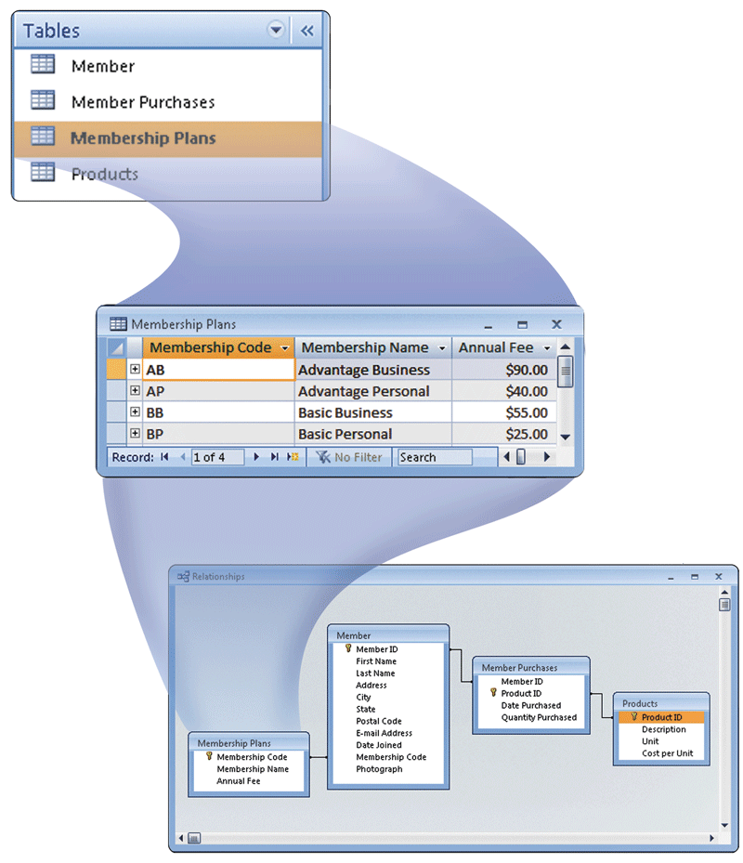
3.0 The Relational Model A Glance Of The Big Concept

Slide 5
3.0 The Relational Model 3.1 A Logical View Of Data
Relational model
Enables programmer to view data logically rather than physically
Table
Has advantages of structural and data independence
Resembles a file from conceptual point of view
Easier to understand than its hierarchical and network database

Slide 6
3.0 The Relational Model 3.1 A Logical View Of Data: Table and Their Characteristics
Table:
two-dimensional structure composed of rows and columns
Contains group of related entities = an entity set
Remember this: Entity = Table = Relation
Terms entity set and table are often used interchangeably
Table also called a relation because the relational model’s creator, Codd, used the term relation as a synonym for table
Think of a table as a persistent relation:
A relation whose contents can be permanently saved for future use

Slide 7
3.0 The Relational Model 3.1 A Logical View Of Data: Table and Their Characteristics
Characteristics Of A Relational Table
1 | Two dimensional structure :: rows & columns
2 | Each table row (tuple) represent a single entity occurrence to the entity set
3 | Each column represents an attribute and each column has a distinct name
4 | Each row/column intersection represent a single data value
5 | All value in a column must confirm to the same data format
6 | Each column has a specific range of values know as attribute domain
7 | The order of the rows and columns is unimportant to DBMS
8 | Each table must have an attribute or a combination of attribute that uniquely identifies each row

Slide 8
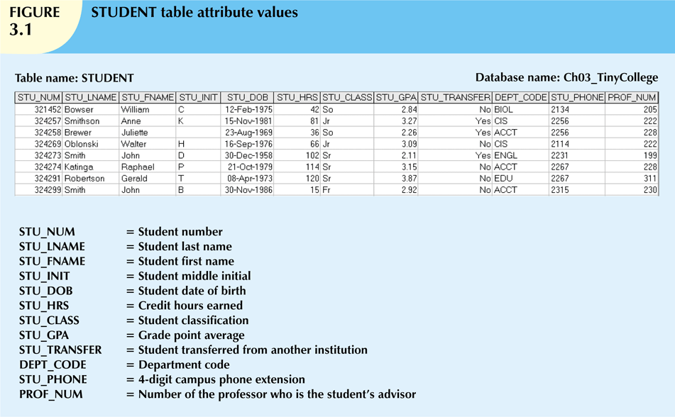
3.0 The Relational Model 3.1 A Logical View Of Data: Table and Their Characteristics

Slide 9
3.0 The Relational Model 3.1 A Logical View Of Data: Table and Their Characteristics
STUDENT(STU_NUM,STU_LNAME,STU_FNAME,STU_INIT)
Table
Relational
Schema
STU_NUM
STU_LNAME
STUDENT
ERD/ERM
STU_FNAME
STU_INIT

Slide 10
3.0 The Relational Model 3.1 A Logical View Of Data: Table and Their Characteristics

Slide 11
3.0 The Relational Model 3.2 Keys: The Concepts
Each row in a table must be uniquely identifiable
Key is one or more attributes that determine other attributes
Key’s role is based on determination
If you know the value of attribute A, you can determine the value of attribute B
A → B
Functional dependence
An attribute is functionally dependent on another if can be determined by that attribute
Attributes are fully functionally dependent on PK
A → B (A determines B)
E.g:
STUDENT(STUDENT_NO, STUDENT_NAME, STUDENT_ICNO,…)
STUDENT_NO → STUDENT_NAME
STUDENT_NO → STUDENT_ICNO

Slide 12
3.0 The Relational Model 3.2 Keys: Types
Composite Key
composed of more than one attribute
Key Attribute
any attribute that is part of a key
Superkey
any key that uniquely identifies each row
Candidate key
Surrogate Key
a superkey without redundancies
artificial or identity key/a substitution for the PK
Primary Key (PK)
an attribute (or a combination of attributes) that uniquely identifies any given entity (row)
Foreign key (FK)
an attribute whose values match PK values in the related table
Secondary key
Key used strictly for data retrieval purposes

Slide 13
3.0 The Relational Model 3.2 Keys: Types (Primary Key)
PK must has unique value!
It can be a single attribute or combination of attributes
STU_NUM is a primary key in STUDENT table
STU_NUM is used to identify each row in this table
SELECT * FROM STUDENT WHERE STU_NUM = 324273

Slide 14
3.0 The Relational Model 3.2 Keys: Types (Composite Key & Key Attribute)
STU_LNAME, STU_FNAME, STU_INIT, STU_PHONE can be used to produce unique matches for remaining attributes. These combination of attributes we called as Composite Key. Each attribute involved we called as key attribute.
STU_LNAME, STU_FNAME, STU_INIT → STU_GPA
(STU_LNAME, STU_FNAME, STU_INIT determine STU_GPA)
SELECT * FROM STUDENT WHERE STU_LNAME = ‘Robertson’ AND STU_FNAME = ‘Gerald’ AND STU_INIT = ‘T’ AND STU_PHONE = 2267
How about this one? SELECT * FROM STUDENT WHERE STU_LNAME = ‘Smith’ AND STU_FNAME = ‘John’

Slide 15
3.0 The Relational Model 3.2 Keys: Types (Superkey)
STU_NUM or STU_NUM, STU_LNAME or STU_NUM, STU_LNAME, STU_INIT can be used to identify each row uniquely => superkey
A Superkey is either PK or Composite Key
STU_NUM → STU_GPA or STU_LNAME, STU_FNAME, STU_INIT → STU_PHONE
SELECT * FROM STUDENT WHERE STU_NUM = 324273
SELECT * FROM STUDENT WHERE STU_NUM = 324273 AND STU_LNAME = ‘Smith’ AND STU_INIT = ‘D’

Slide 16
3.0 The Relational Model 3.2 Keys: Types (Candidate Key)
Candidate key = a Superkey without redundancies/any key or group of keys that could become a Superkey
STU_NUM is a candidate key
STU_LNAME, STU_FNAME, STU_INIT, STU_PHONE is a candidate key
STU_LNAME, STU_FNAME is NOT a candidate key. Why?

Slide 17
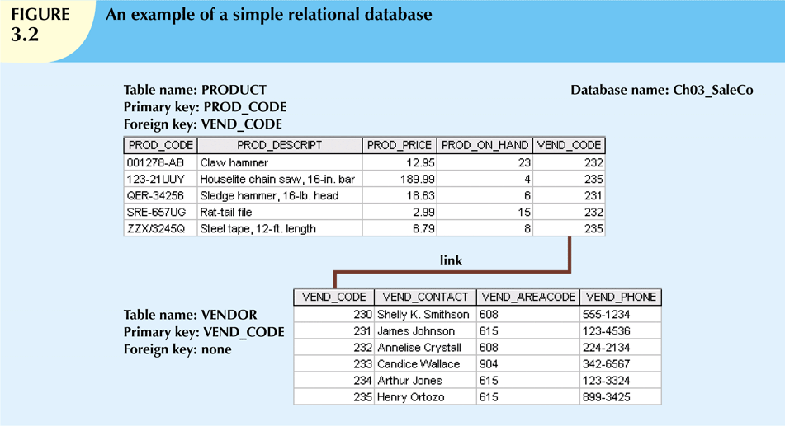
3.0 The Relational Model 3.2 Keys: Types (Foreign Key)
PRODUCT and VENDOR are linked through VEND_CODE

Slide 18
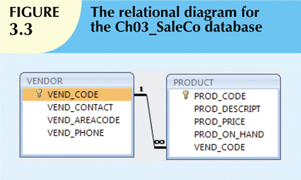
3.0 The Relational Model 3.2 Keys: Types (Foreign Key)
Referential integrity
FK MUST have a valid entry in the corresponding table (or be NULL)
PK entry CANNOT be deleted if a FK refers to it

Slide 19
3.0 The Relational Model 3.2 Keys: Types (Secondary Key)
Secondary key = key(s) is/are used strictly for data retrieval purposes
Instead of using STU_NUM to identify student, we might use STU_LNAME, STU_FNAME, STU_INIT to identify student as well
The result not necessarily is a single result
In real world, I can search your academic record using name, faculty, program, campus and etc. Those attributes are example of secondary keys.

Slide 20
3.0 The Relational Model 3.2 Keys: Types

Slide 21
3.0 The Relational Model 3.2 Keys: Nulls
Nulls:
No data entry/something is unknown, therefore, insert NULL to a particular attribute
Not permitted in primary key
Should be avoided in other attributes
Can represent
An unknown attribute value
A known, but missing, attribute value
A “not applicable” condition
Can create problems when functions such as COUNT, AVERAGE, and SUM are used
Can create logical problems when relational tables are linked
Solution: assign default value
if(price == 0 || price == NULL)

Slide 22
3.0 The Relational Model 3.2 Keys: Nulls
Examples:
Table name: member
IDmember | name | street | city | postcode | telephone | datejoined
10001 | Syakirin | 123 Desa Jaya | Jengka | 26400 | 09-575755 | 2/1/1998
10002 | Islah |  |  |  | 00000000 | 3/4/1997
10003 | Ihsan | 5 Skudai Kiri | Johor | 81300 | 07-564233 | 12/31/2001
** null

Slide 23
3.0 The Relational Model 3.2 Keys: Controlled Redundancy
Controlled redundancy:
Makes the relational database work
Tables within the database share common attributes that enable the tables to be linked together
Multiple occurrences of values in a table are not redundant when they are required to make the relationship work
Redundancy exists only when there is unnecessary duplication of attribute values
The importance keys for maintain controlled redundancy are:
Foreign key (FK)
Primary key (PK)
Controlled Redundancy may lead to;
Referential integrity
FK contains a value that refers to an existing valid tuple (row) in another relation

Slide 24
3.0 The Relational Model 3.3 Integrity Rules Revisited: Entity Integrity
Entity Integrity | Description
Requirement | All PK entries are unique, and cannot be null
Purpose | Each row will have a unique identity, and FK can properly reference primary key values
Example | No invoice can have duplicate number, nor it can be null. In short, all invoices are uniquely identified by their invoices number

Slide 25
3.0 The Relational Model 3.3 Integrity Rules Revisited: Referential Integrity
Referential Integrity | Description
Requirement | A FK may have either a null entry-as long as it is not a parts of it table’s PK – or an entry that matches the PK value in a table to which it is related
Purpose | It is possible for an attribute NOT to have corresponding value, but it will be impossible to have an invalid entry. The enforcement of the referential integrity rule make it is impossible to delete a row in one table whose PK has mandatory matching FK values in another table.
Example | A customer might not yet have an assigned sales representative no, but it will be impossible to have an invalid sales representative no

Slide 26
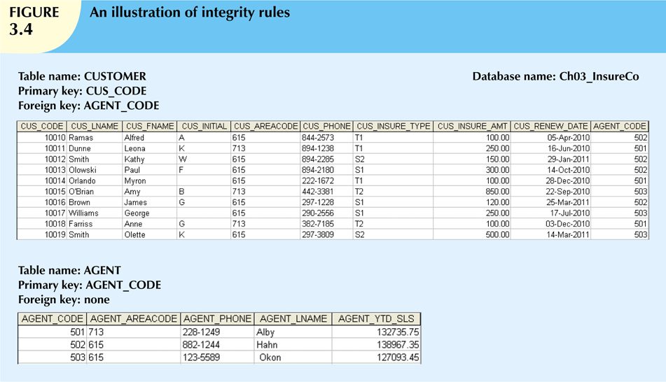
3.0 The Relational Model 3.3 Integrity Rules Revisited: Integrity Rules

Slide 27
3.0 The Relational Model 3.3 Integrity Rules Revisited: Integrity Rules
Entity Integrity
Referential Integrity
Table | Entity Integrity | Explanation
Table | Referential Integrity | Explanation

Slide 28
3.0 The Relational Model 3.3 Relational Set Operators
Relational algebra (RA)
Defines theoretical way of manipulating table contents using relational operators
Use of relational algebra operators on existing relations produces new relations:
SELECT | DIFFERENCE
PROJECT | JOIN
UNION | PRODUCT
INTERSECT | DIVIDE

Slide 29
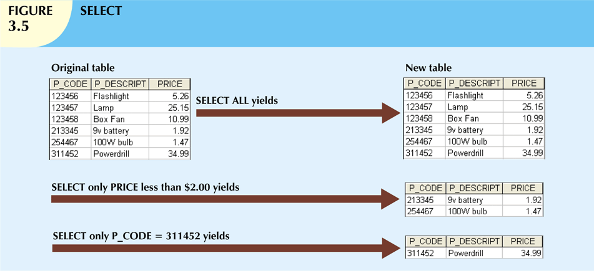
3.0 The Relational Model 3.3 Relational Set Operators
: Retrieve values for all rows found in a table

Slide 30
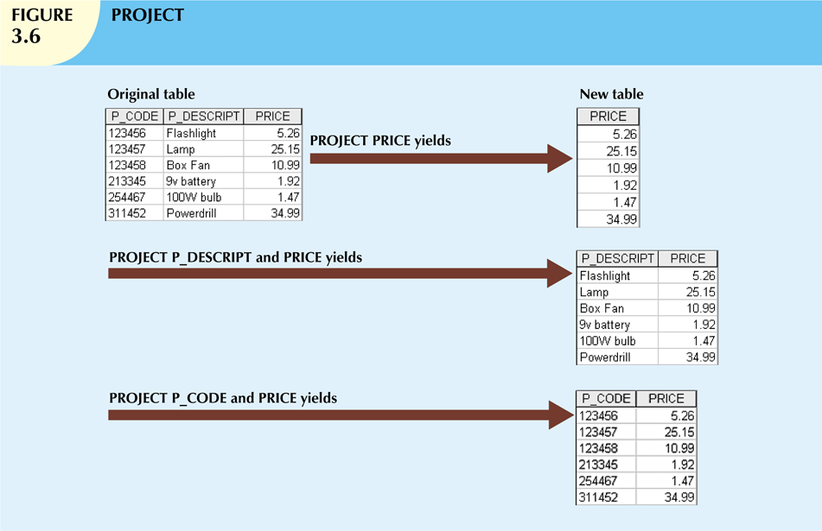
3.0 The Relational Model 3.3 Relational Set Operators
: retrieves all values for selected attributes

Slide 31
3.0 The Relational Model 3.3 Relational Set Operators
Table: Employee
nr | name | salary
1 | John | 100
5 | Sarah | 300
7 | Tom | 100
 | SELECT | PROJECT
RA | SELECT _{salary < 200} (Employee) | PROJECT _{salary} (Employee)
SQL | SELECT * FROM Employee WHERE salary < 200 | SELECT salary FROM Employee

Slide 32
3.0 The Relational Model 3.3 Relational Set Operators
: combines all rows from two tables
: retrieves rows that appear in both tables

Slide 33
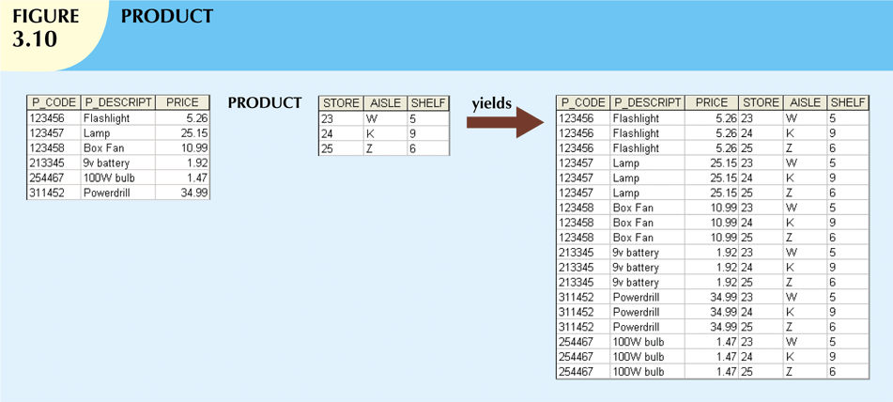
3.0 The Relational Model 3.3 Relational Set Operators
: retrieves all rows in one table that are not found in the other table
: retrieves all possible pairs of rows from two tables. Known as Cartesian Product.

Slide 34
3.0 The Relational Model 3.3 Relational Set Operators
Natural Join
Links tables by selecting rows with common values in common attribute(s) automatically (dangerous!!!)
Don't need to specify column names for the join – it will automatically join same name columns in two different tables
SELECT * FROM employee NATURAL JOIN department;
Equijoin (INNER JOIN)
Links tables on the basis of an equality condition that compares specified columns
SELECT * FROM employee JOIN department ON employee.workdept = department.deptno;
Theta join
Any other comparison operator is used (>, <, >=, =<, <>)
Outer join
Matched pairs are retained, and any unmatched values in other table are left null

Slide 35
3.0 The Relational Model 3.3 Relational Set Operators

Slide 36
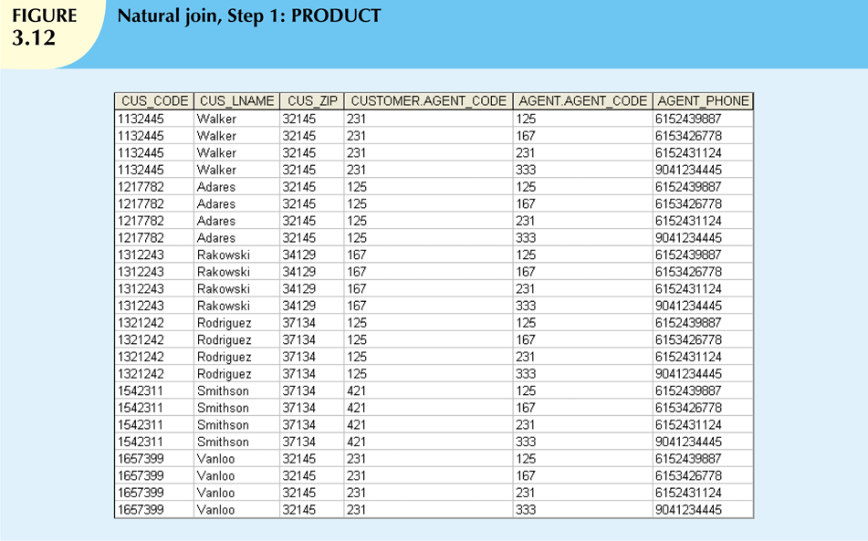
3.0 The Relational Model 3.3 Relational Set Operators

Slide 37
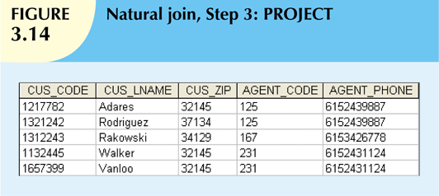
3.0 The Relational Model 3.3 Relational Set Operators

Slide 38
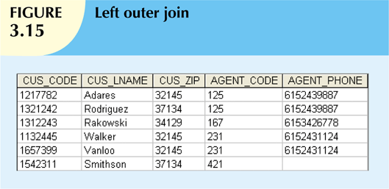
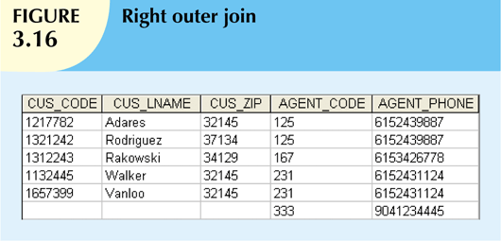
3.0 The Relational Model 3.3 Relational Set Operators
left outer join, which keeps all the rows from the left table. If a row can't be connected to any of the rows from the right table according to the join condition, null values are used
right outer join, which keeps all the rows from the right table. If a row can't be connected to any of the rows from the left table according to the join condition, null values are used

Slide 39
3.0 The Relational Model 3.3 Relational Set Operators
Table: Student
Table: Course
studNo | studName | courseId
100 | Fred | PH
200 | Dave | CM
400 | Peter | EN
courseId | Name
PH | Pharmacy
CM | Computing
CH | Chemistry
studNo | studName | courseId | courseId | Name
100 | Fred | PH | PH | Pharmacy
200 | Dave | CM | CM | Computing
400 | Peter | EN | null | null
LEFT OUTER JOIN
studNo | studName | courseId | courseId | Name
100 | Fred | PH | PH | Pharmacy
200 | Dave | CM | CM | Computing
null | null | null | CH | Chemistry
RIGHT OUTER JOIN

Slide 40
3.0 The Relational Model 3.3 Relational Set Operators
A
B

Slide 41
3.0 The Relational Model 3.4 Data Dictionary & System Catalog
Data dictionary
Provides detailed accounting/info of all tables found within the user/designer-created database
Contains (at least) all the attribute names and characteristics for each table in the system
Contains metadata: data about data
System catalog
Contains metadata
Detailed system data dictionary that describes all objects within the database

Slide 42
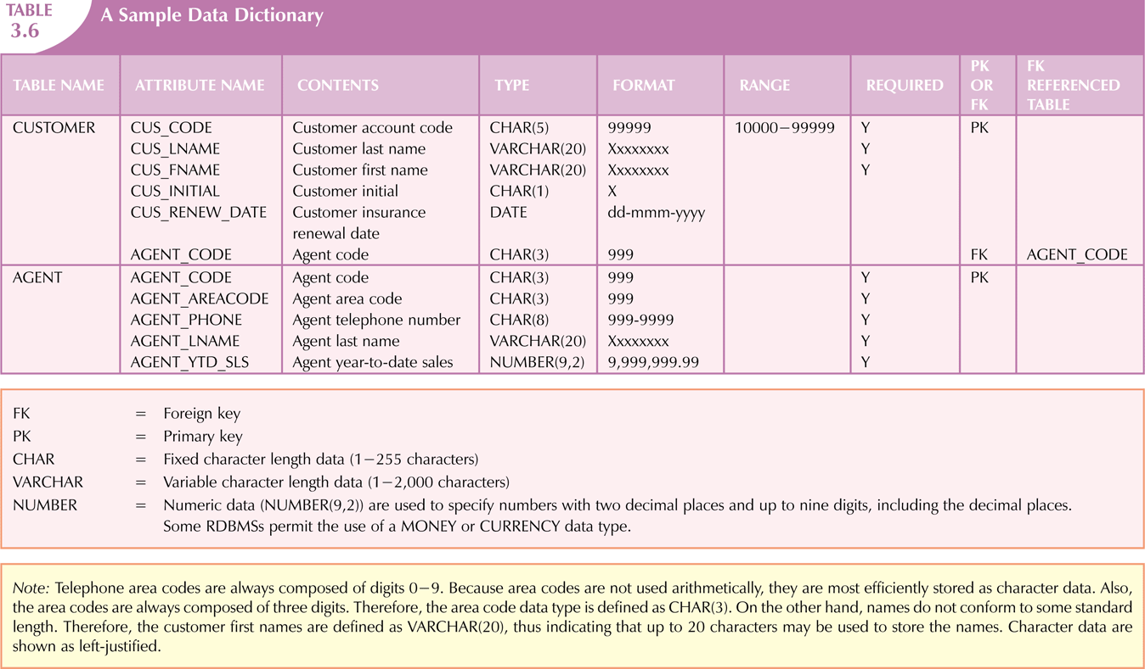
3.0 The Relational Model 3.4 Data Dictionary & System Catalog

Slide 43
3.0 The Relational Model 3.5 Relationship Within Relational Database
Relationship is a logical interaction among the entities in a relational database.
Operate in both directions
There are 3 basic relationship in a database;
(1:1)
one-to-one
(1:M)
one-to-many
(M:N)
many-to-many
cannot be implemented as such in the relational model
m:n relationships can be changed into two 1:m relationships
relational modeling ideal
should be norm in any relational database design
should be rare in any relational database

Slide 44
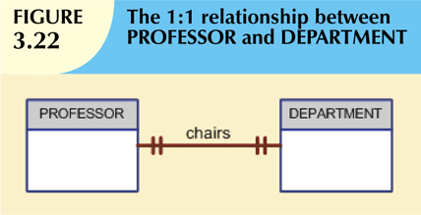
3.0 The Relational Model 3.5 Relationship Within Relational Database: 1:1 Relationship
One entity related to only one other entity, and vice versa
Sometimes means that entity components were not defined properly
Could indicate that two entities actually belong in the same table
Certain conditions absolutely require their use

Slide 45
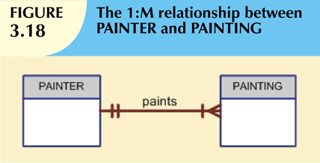
3.0 The Relational Model 3.5 Relationship Within Relational Database: 1:M Relationship
Relational database norm
Found in any database environment

Slide 46
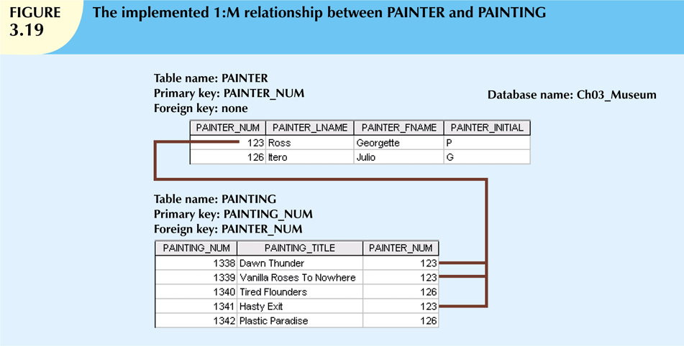
3.0 The Relational Model 3.5 Relationship Within Relational Database: 1:M Relationship

Slide 47
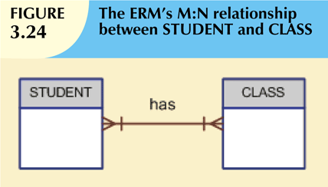
3.0 The Relational Model 3.5 Relationship Within Relational Database: M:N Relationship
Implemented by breaking it up to produce a set of 1:M relationships
Avoid problems inherent to M:N relationship by creating a composite entity
Includes as foreign keys the primary keys of tables to be linked

Slide 48
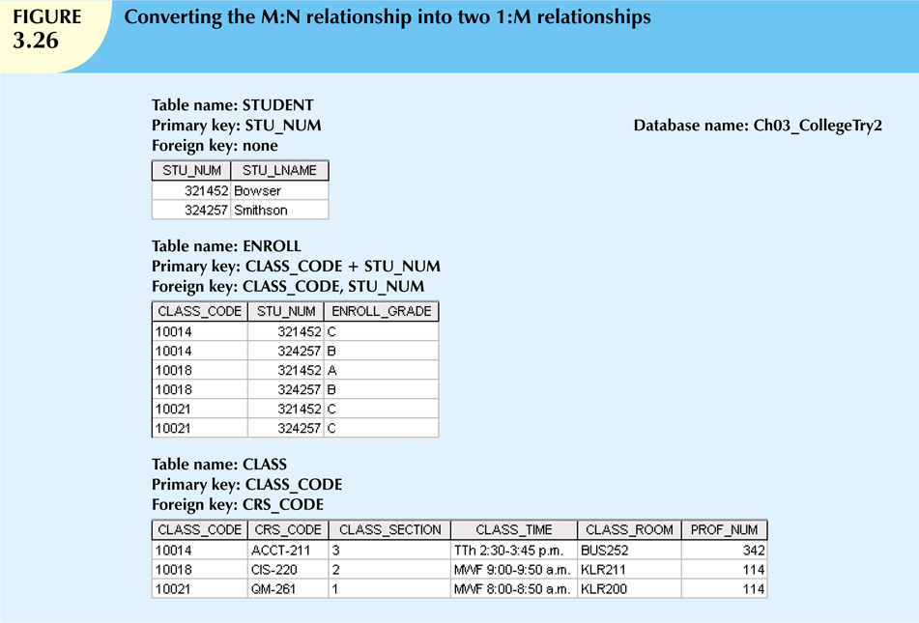
3.0 The Relational Model 3.5 Relationship Within Relational Database: M:N Relationship

Slide 49
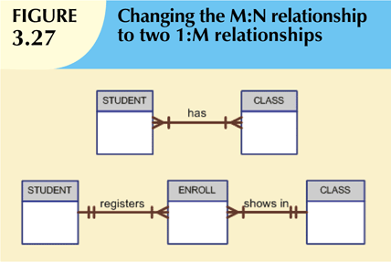
3.0 The Relational Model 3.5 Relationship Within Relational Database: M:N Relationship

Slide 50
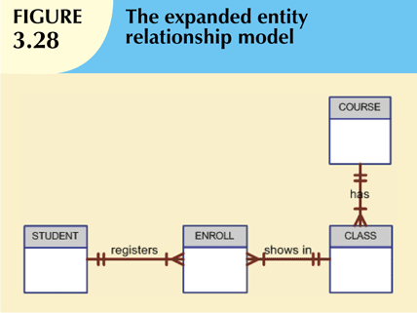
3.0 The Relational Model 3.5 Relationship Within Relational Database: M:N Relationship

Slide 51
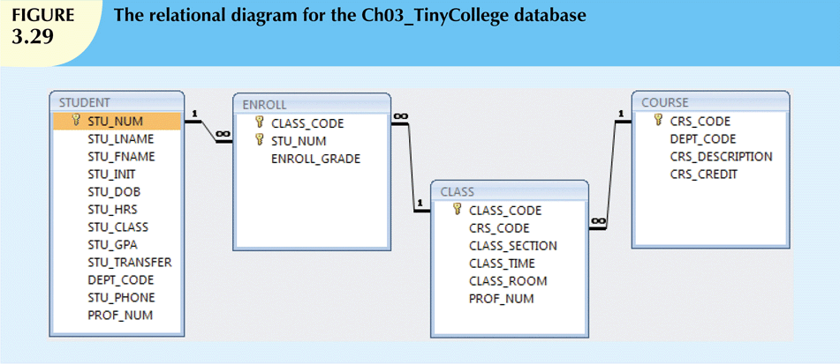
3.0 The Relational Model 3.5 Relationship Within Relational Database: M:N Relationship

Slide 52
3.0 The Relational Model 3.6 Data Redundancy Revisited
Data redundancy leads to data anomalies
Such anomalies can destroy the effectiveness of the database
Foreign keys
Control data redundancies by using common attributes shared by tables
Crucial to exercising data redundancy control
Sometimes, data redundancy is necessary

Slide 53
3.0 The Relational Model 3.6 Data Redundancy Revisited

Slide 54
3.0 The Relational Model 3.7 Indexes
Arrangement used to logically access rows in a table
Index key
Index’s reference point
Points to data location identified by the key
Unique index
Index in which the index key can have only one pointer value (row) associated with it
It can be PK or any unique value such as Phone Num, Email, etc
Each index is associated with only one table

Slide 55
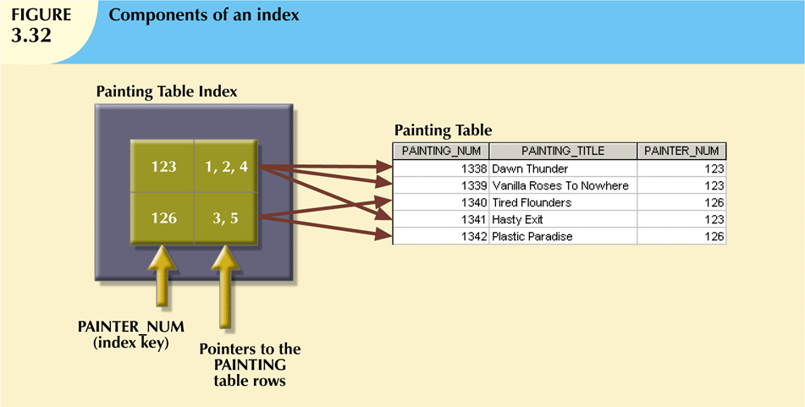
3.0 The Relational Model 3.7 Indexes

Slide 56
3.0 The Relational Model Codd’s Relational Database Rules
In 1985, Codd published a list of 12 rules to define a relational database system
Products marketed as “relational” that did not meet minimum relational standards
Even dominant database vendors do not fully support all 12 rules

Slide 57
3.0 The Relational Model Summary
Tables are basic building blocks of a relational database
Keys are central to the use of relational tables
Keys define functional dependencies
Superkey
Candidate key
Primary key
Secondary key
Foreign key

Slide 58
3.0 The Relational Model Summary
Each table row must have a primary key that uniquely identifies all attributes
Tables are linked by common attributes
The relational model supports relational algebra functions
SELECT, PROJECT, JOIN, INTERSECT UNION, DIFFERENCE, PRODUCT, DIVIDE
Good design begins by identifying entities, attributes, and relationships
1:1, 1:M, M:N

